Slide 1
Health and Harmony Update

Slide 2
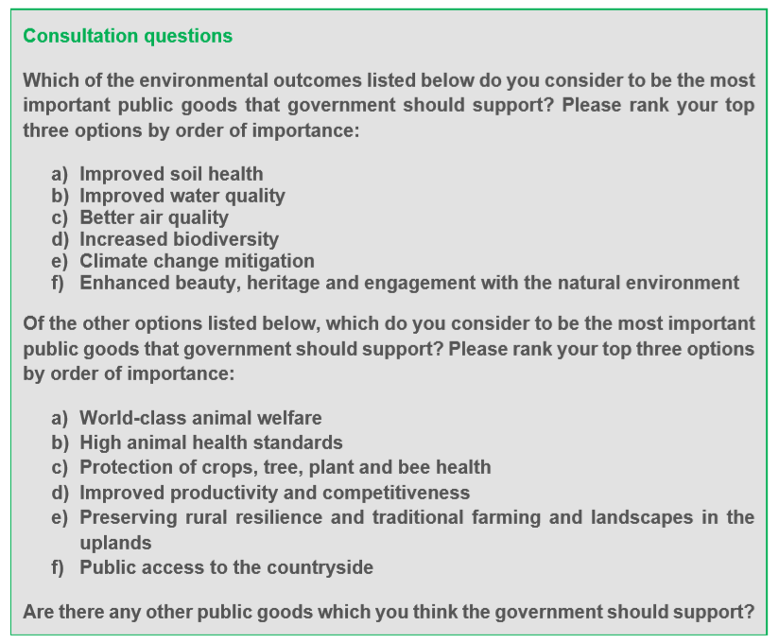
Consultation Questions

Slide 3
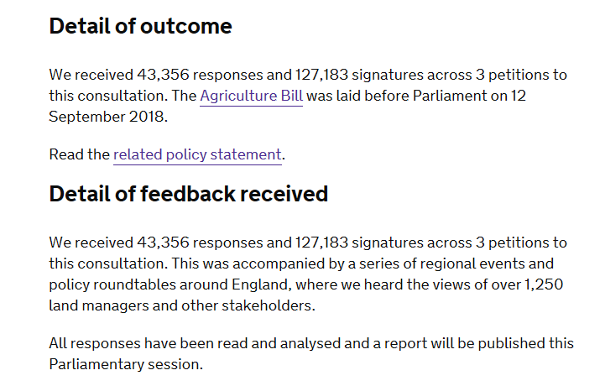
Response to consultation

Slide 4
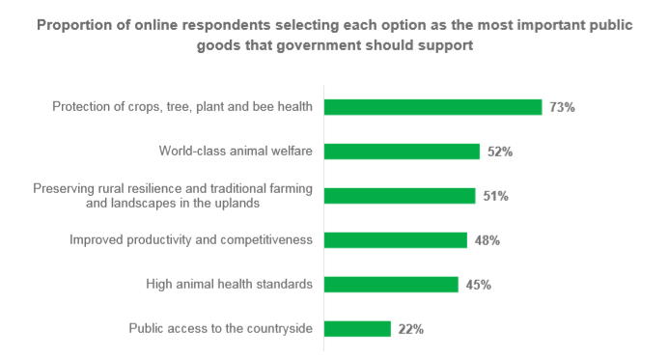
Consultation Results

Slide 5
Right To Roam

Slide 6
Make sure farmers fulfil their existing legal responsibilities

Slide 7
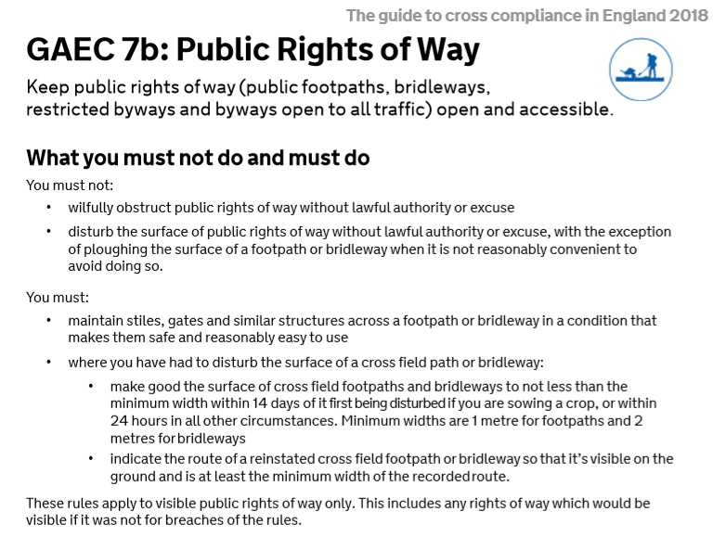
Current Guidelines

Slide 8
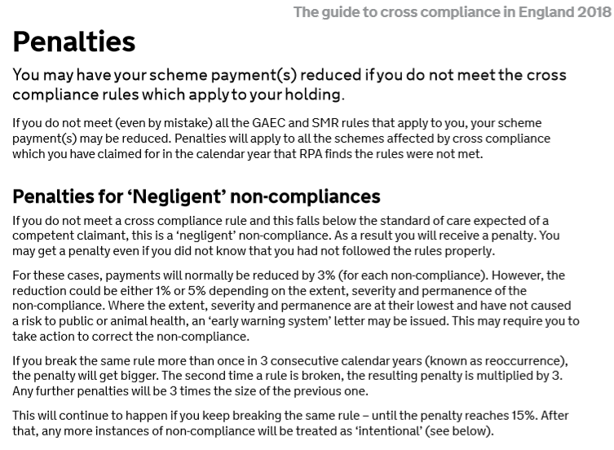
Current Penalities

Slide 9
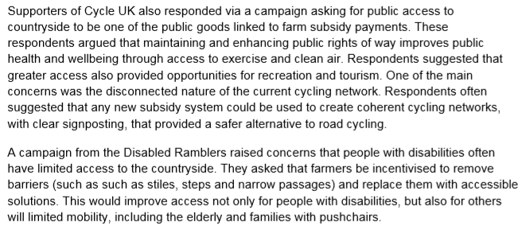
Cycle UK & The Disabled Ramblers

Slide 10
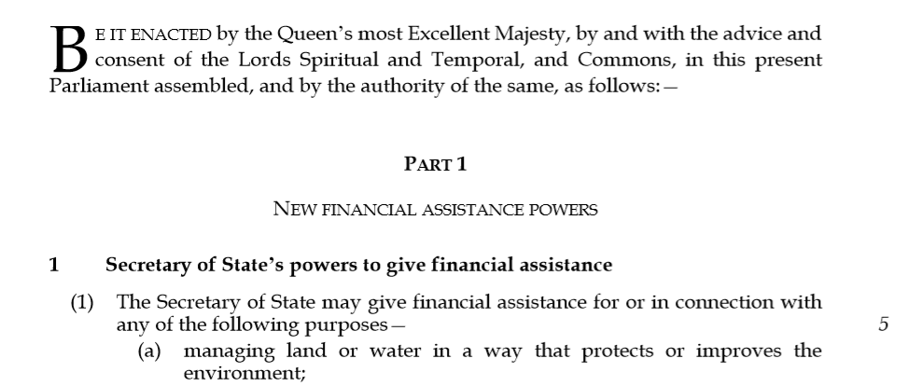
The 2017-2019 Agriculture Bill

Slide 11
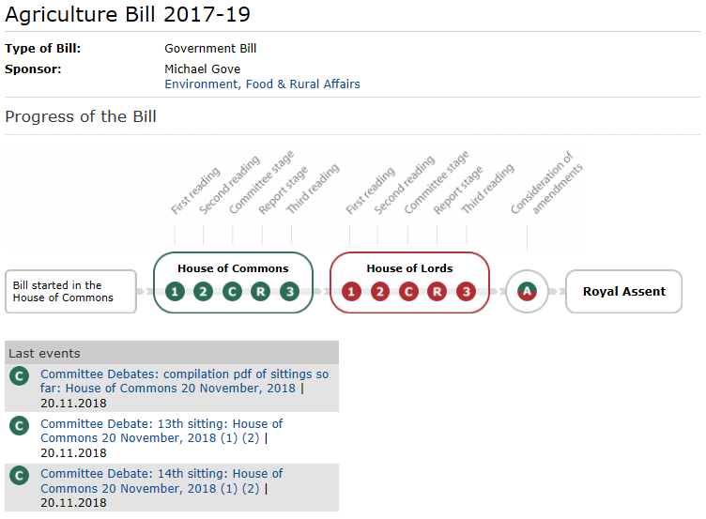
The Future

