Slide 1


New Forest National Park Local Plan 2016 - 2036
Reg 18 Initial Consultation (Autumn 2015)
Consultation draft Local Plan (October 2016)
Consultation on potential alternative housing sites (June 2017)
Potential Adoption date for new Local Plan (Spring 2019)
Examination Hearing Sessions (November 2018)
Reg 19 Consultation on Submission draft Local Plan (January 2018)

Slide 2
Local Plan – Access specific matters
National policy requires planning authorities to seek opportunities to protect and enhance public rights of way and access; and create safe and secure places for recreation.
Policy SP55 supports: (i) improvements to existing rights of way; and (ii) the creation of a more joined up network of routes. This provides a policy hook to consider future proposals.
Policy SP24 supports the provision of 1ha of new natural greenspace to serve village of Sway (3,000 people) as part of a proposed 40-dwelling housing allocation.
Reference to the England Coast Path in the Calshot housing allocation (Policy SP26).
The NPA’s Habitat Mitigation Scheme is being updated and this will include continued support for alternative recreation sites and routes outside the designated sites.
Housing site allocations proposed in accessible locations that relate well to existing rights of way and access routes (e.g. Whartons Lane, Ashurst).

Slide 3
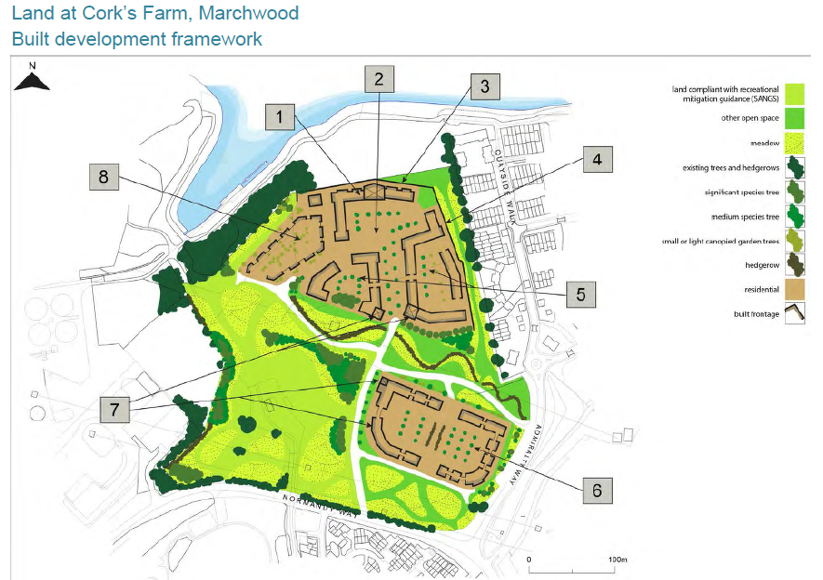

Slide 4
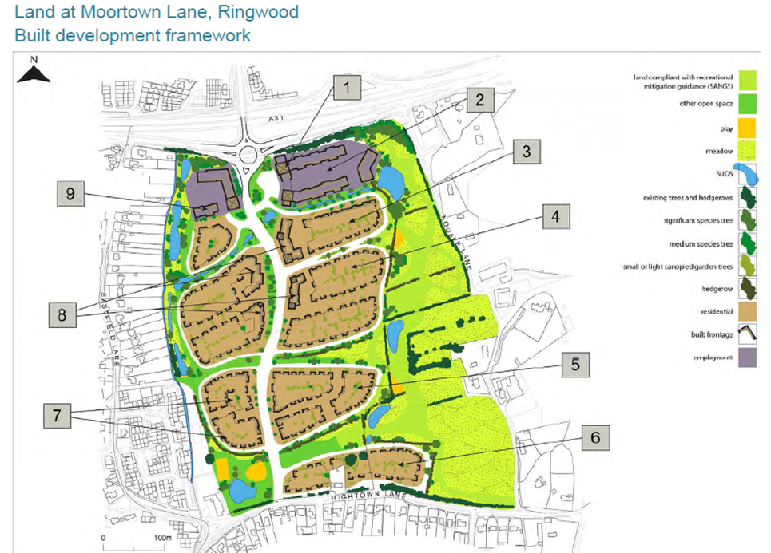

Slide 5
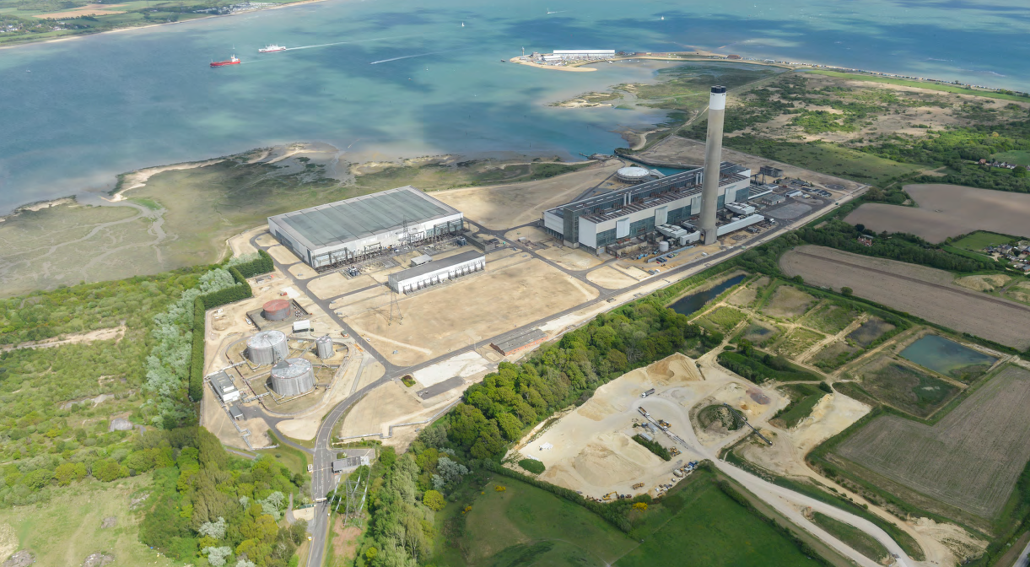

Slide 6
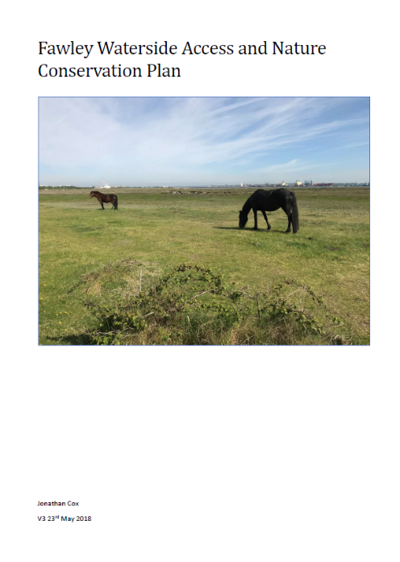
The NPA’s draft Local Plan 2016 – 2036 allocation at Fawley is based on clear net positive public benefits in relation to landscape, public access improvements and the provision of suitable greenspace for recreation.
At least 30 hectares of new accessible greenspace must be provided (8ha per 1,000 people). Proposals include:
14.4ha at the former Exxon Laydown Land, which currently comprises large areas of hard standing;
21ha of land at the restored Badminston Quarry site. Chambers Copse ancient woodland will remain free from public access as a nature reserve.
The single land ownership enables significant landscape, habitat and access benefits to be delivered. This will moderate impacts, as required by the NPPF.

Slide 7
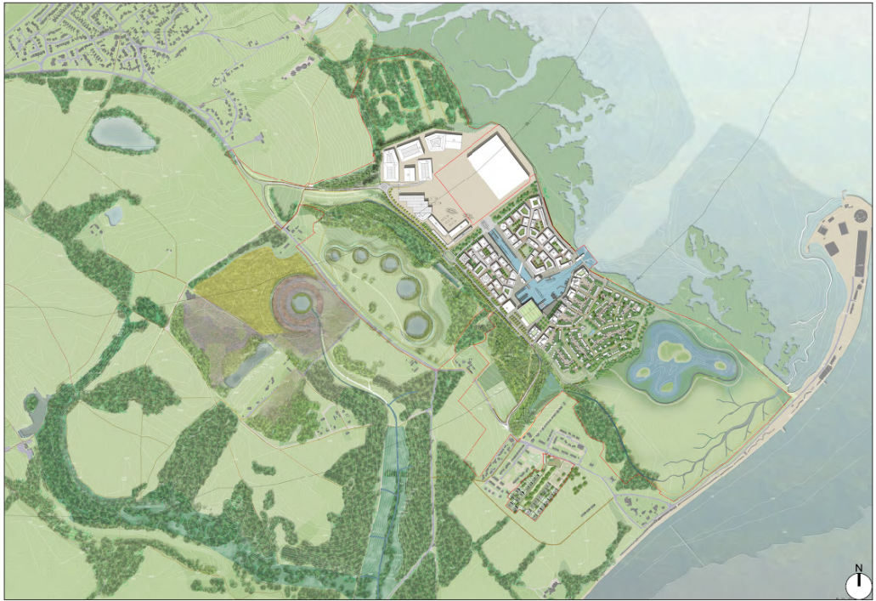

Slide 8
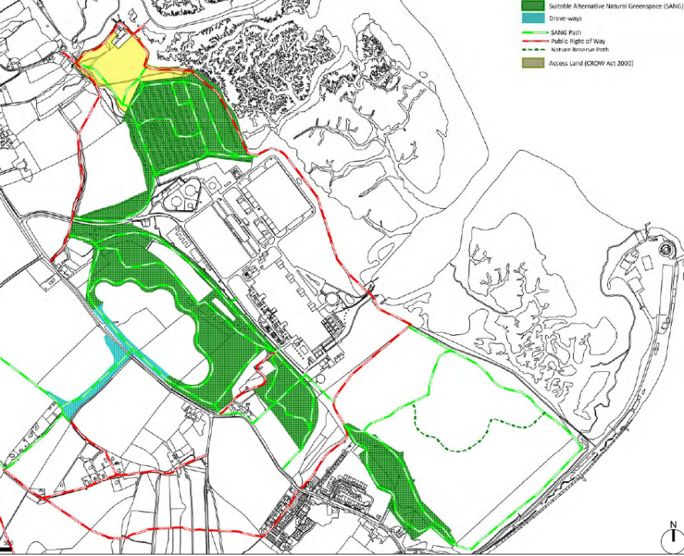
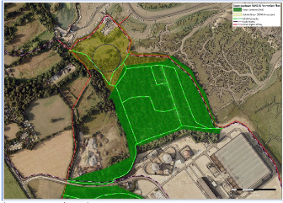
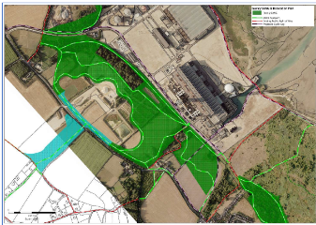
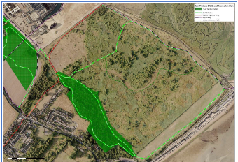

Slide 9
