Slide 1

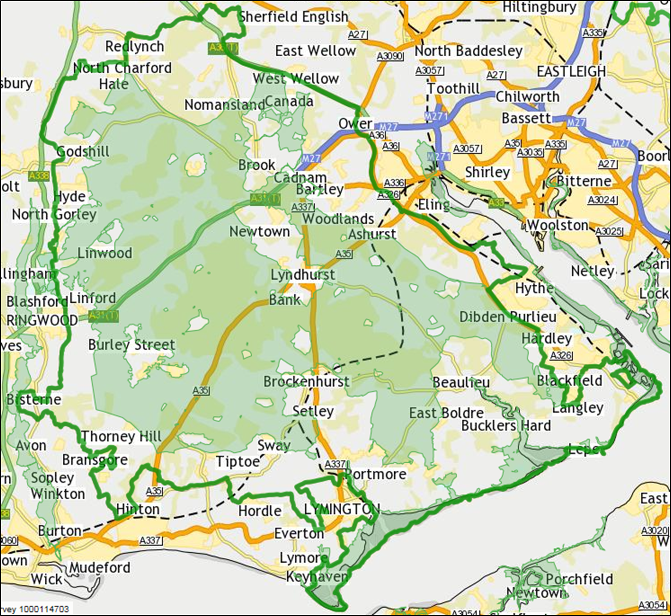
New research into visits to the New Forest
New Forest Access Forum 11 June 2018
The research is driven by the scale of planned housing development around the New Forest and the wealth of internationally protected habitats within the Park.
Circa 60% of the National Park is designated as being of international importance for nature conservation.

Slide 2
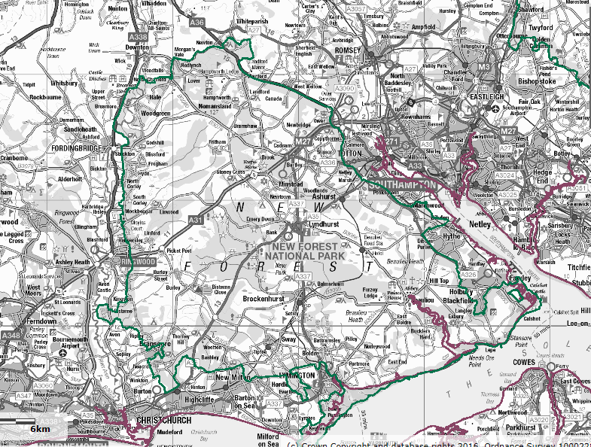
WC
6,700 dwellings
TVBC
3,500 dwellings*
SCC
19,500 dwellings
NFDC
10,000 dwellings
C&EDDC8,500 dwellings

Slide 3
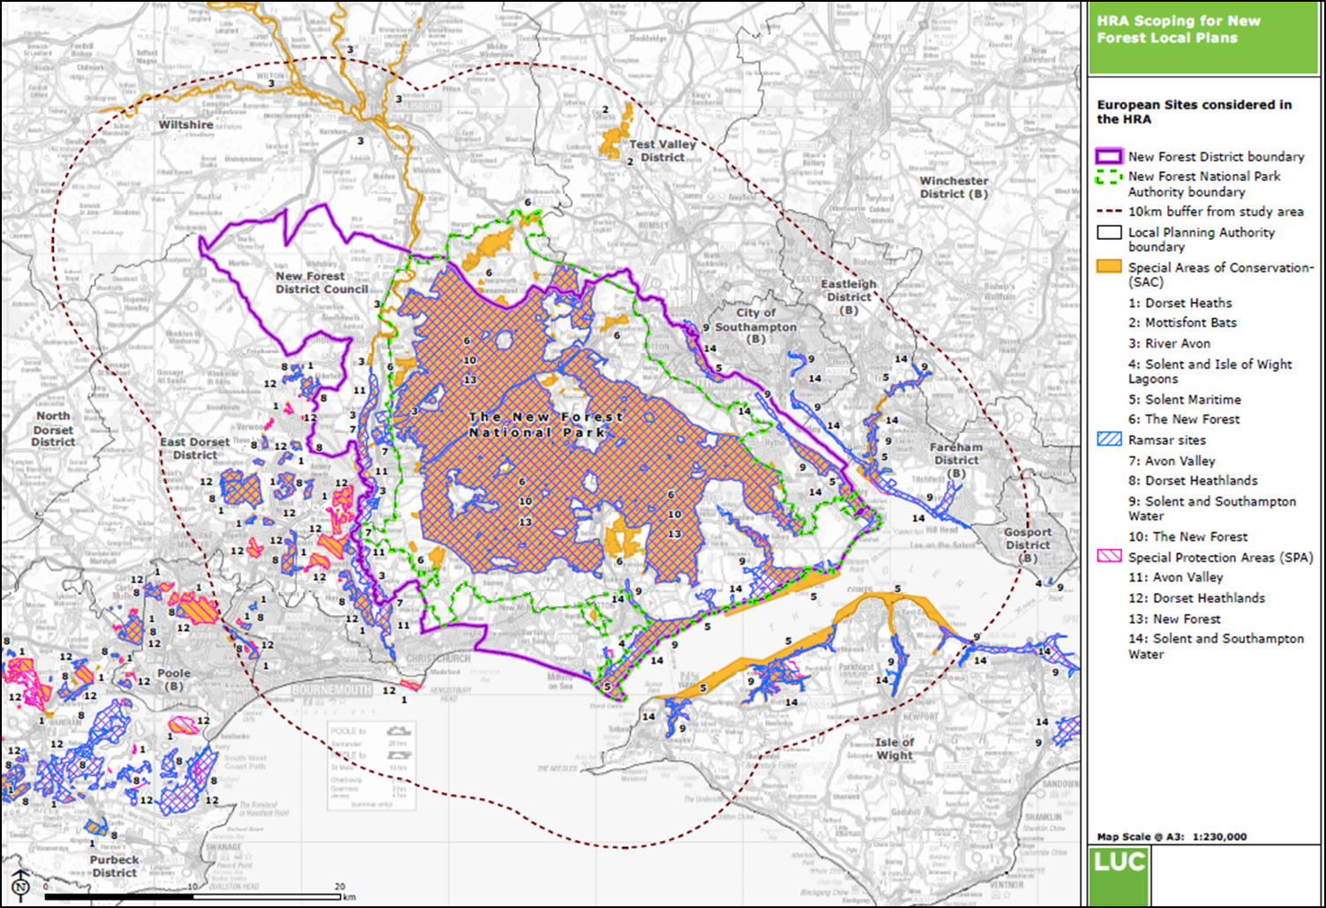

Slide 4
Summary of existing approach to habitat mitigation measures
A range of approaches are taken by planning authorities around the New Forest, with variations in both the level of financial contribution and the distance from the New Forest within which it is sought.
NFNPA – contributions sought since 2012
NFDC – contributions sought since 2014 from all development
TVBC – contributions sought since 2014 from development within 13.5km of the New Forest SPA
Wiltshire Council – commitment to prepare a mitigation strategy in the adopted Core Strategy, but not yet in place
Southampton City Council and Eastleigh Borough Council – Draft Local Plan HRAs recognise potential impacts on the New Forest, but to date no mitigation measures in place

Slide 5
Overview of bid to MHCLG
January 2018
Bid submitted to the Government’s ‘Joint Working Fund’ in January 2018.
Submitted jointly by 6 planning authorities and Natural England.
The aim is to develop a co-ordinated, cross boundary approach to ensuring the impacts of development are appropriately mitigated.
The funding will help to deliver the New Forest National Park Partnership Plan 2015 – 2020 action to: “Reduce the impacts of any new development which may have an effect on the internationally protected habitats and species of the National Park by access management, education and awareness raising projects and the provision of new or improved areas for countryside recreation, all funded by developer contributions.”

Slide 6
Indicative timetable for the work
Date | Action
May 2018 | Invitation to tender document issued
Summer 2018 – March 2019 | Survey work undertaken to cover both peak and off-peak visitor periods. This includes on-site surveys and telephone surveys
By March 2019 | Establish a model/catchment to estimate current and future numbers of people and activities in relation to the distribution of new housing numbers
Spring 2019 | Establish strategic mitigation framework required for future development

Slide 7
Outcomes
Funding will help progress work on delivering the homes needed in the area while conserving the natural environment.
The output of Phase 1 will be:-
To identify the profile of visitors to the New Forest SPA in terms of visitor type (i.e. local residents, leisure day visitors and staying visitors) and where the visitors have originated.
Using the evidence from Phase 1 the outcomes of Phase 2 would be:-
To establish a catchment area identifying where population growth would have an impact on the New Forest SPA; and
To identify potential options for mitigating the impact, leading towards a strategic mitigation framework, which includes establishing a justifiable approach for developer contributions.

Slide 8
Outcomes 2
The final part of the study will make recommendations on appropriate mitigation options that will work specifically in the New Forest. This may include:
avoidance / diversion techniques
visitor / access management techniques
the use of suitable alternative natural greenspace (SANG)
alternative recreation routes
influencing behaviour through education and interpretation
This part of the study will build on the mitigation work already being funded by developer contributions sought from new development within the National Park and New Forest District.

